Slide 1
WAF test report
Avinash Gupta and Nitin Bangera
30/08/2023

Slide 2
Index
Tool features and flaws
Automated scanning tool test findings
Manual test findings
DDOS test findings
Other findings

Slide 3
Tool features and flaws
Prophaze | Fortinet
Pros | Pros
Better Analysis of Behavioral attacks | Better Signature based attacks analysis
AIML Engine works on scenario basis | Reporting is good and able to capture most of the information
Blocked the attacker IP's automatically | Better control for administrator to configure DDOS and Bot Mitigation
Awsome Technical support | Integration other fortinet products are easy.
Cons | Cons
Reporting can be better and and logs can be processed in better way | Not able to capture the behaviour patterns of the traffic.
GUI Can be Better | Manual Configuration for DDOS and Signature based traffic.

Slide 4
Security testing
Stagging of test:
Deployed DVWA (dam vulnerable WEB application) on 2 separate azure instances.
Both instance had different public URL.
https://prophaze.fractal.ai (behind Prophaze WAF)
https://fortinet.fractal.ai (behind FortiGate WAF)
From 21-25 Aug we kept it on monitoring/ learning mode.
From 28-29 Aug It was in block mode.

Slide 5
Automated scanning tools test findings
To identify the WAF details implemented on application we used below 4 tools
Tool name | Fortinet | Prophaze
Pentest tool | No | No
WafWoof | Yes | No
WhatWaf | Yes | No
Go test WAF | Yes | No

Slide 6
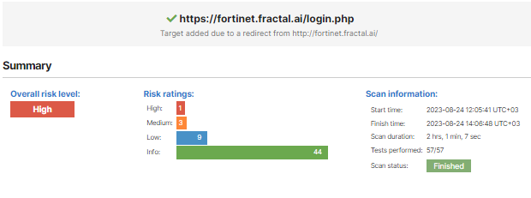
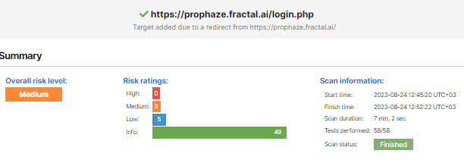
Automated scanning tools test findings
FortiGate:- 1 High and 3 Medium vulnerability was identified, scanner detected the vulnerable software used on the application.
Prophaze:- 3 Medium vulnerability was identified, scanner did not detect the vulnerable software used on the application.

Slide 7
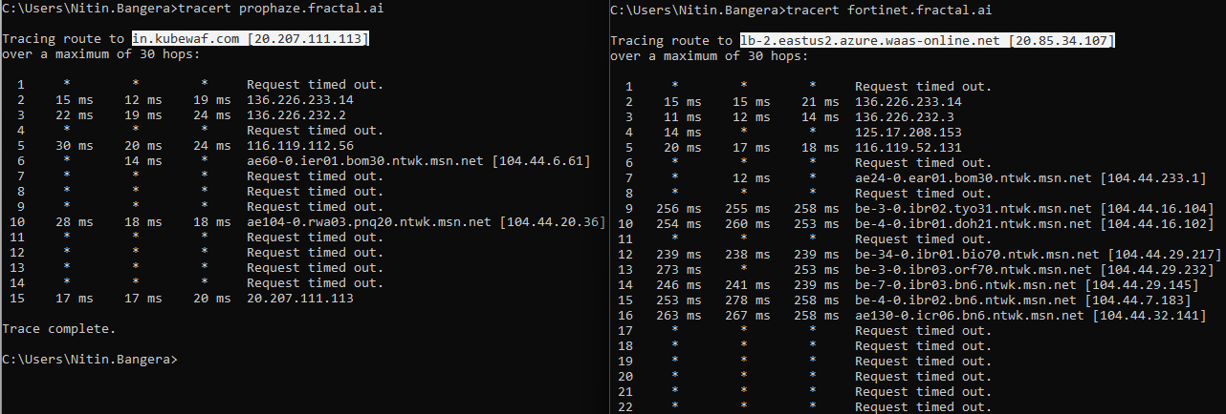
Trace route test

Slide 8
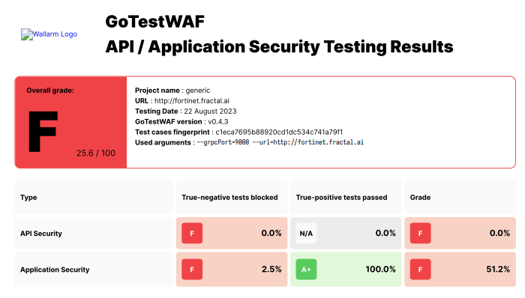
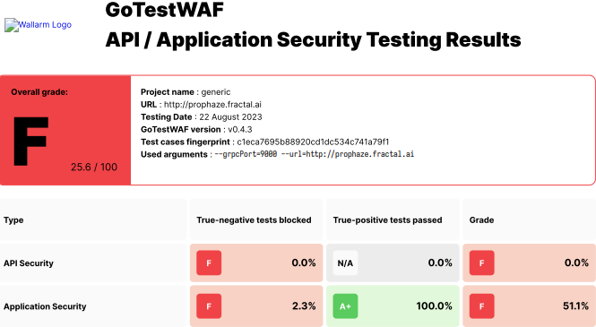
Automated scan monitoring mode

Slide 9
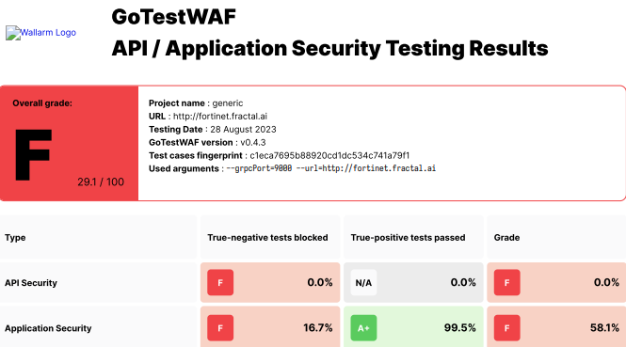
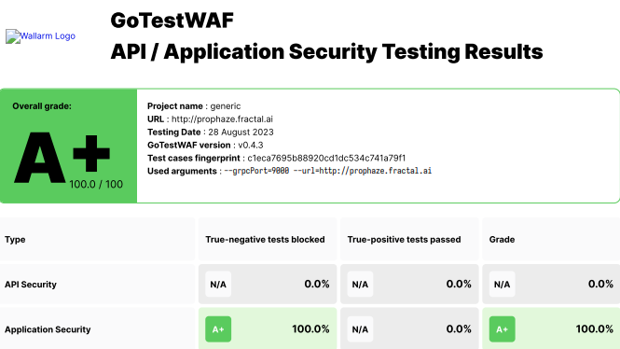
Automated scan block mode

Slide 10
Manual test report
Test Name | Fortinet | Prophaze
SQL injection | Passed | Blocked
Brute force | Passed | Passed
Local file inclusion | Passed | Blocked
RCE | Passed | Blocked
XSS reflected | Blocked | Blocked
Stored XXS | Passed | Blocked
Command injection | Passed | Passed

Slide 11
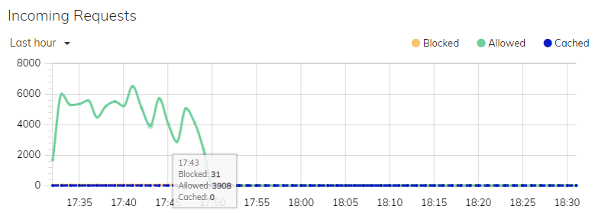
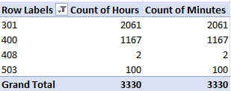
DDOS attack (MHDDOS)
Fortigate: allowed all the traffic to the server.
Prophaze: Redirected most of the request to google or yahoo.com. Blocked several request. 100 request was reverted as service unavailable and went through to the server.

Slide 12
Additional findings
While using automated tool which sent multiple malicious request continuously, Prophaze autoblocked attackers public IP. But FortiGate did not blocked it. Even though both WAFs was in block mode.
For automated tool attacks Prophaze redirect traffic to google.com or yahoo.com.
FortiGate blocks the request and give the signatures ID.

